Slide 1

Concept Video
Assignment 4
Notes:
Hi everyone, thanks for being here. Today we're going to walk you through our process for Assignment 2, which includes developing our Points of View and 'How Might We' questions, and testing three different experience prototypes

Slide 2
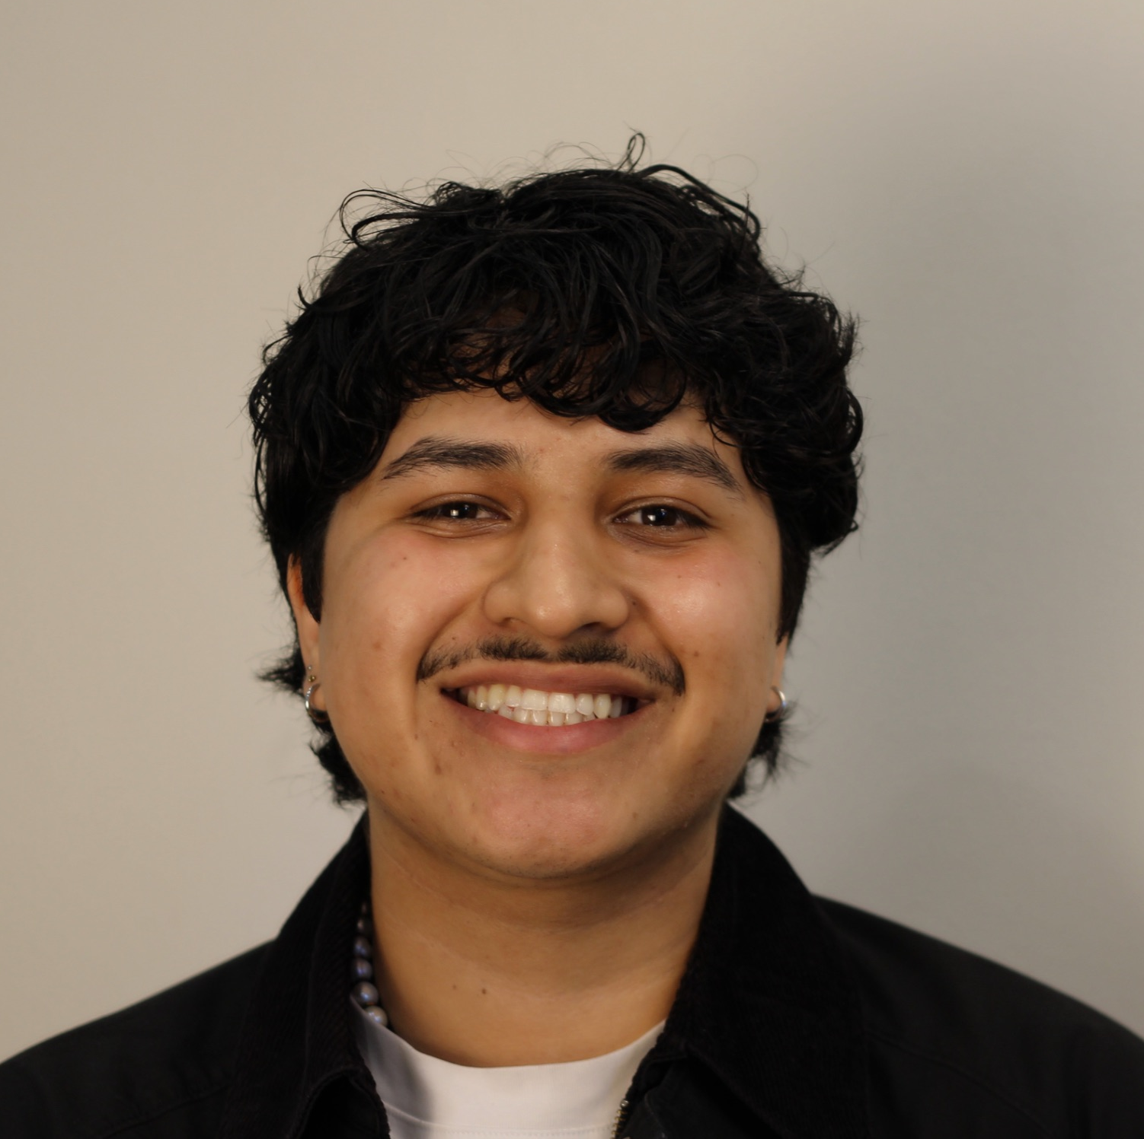


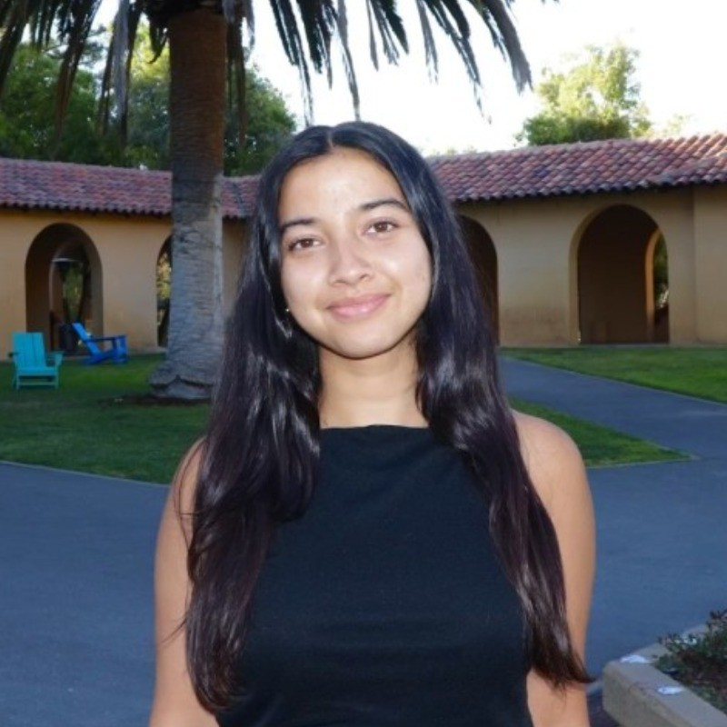
TEAM BAGG
Gil S.
Bennie N.
Gabriella U.
Amesha B.

Slide 3

KYRO
Emotional scheduling that syncs your outer world to your inner world.
‘Kyro’ is a play on “kairos,” the ancient Greek word for the right or opportune moment, hinting towards emotional timing and intuition.
It reflects our belief that emotional well-being isn’t just about managing time, but about making time meaningful and aligning schedules with emotional balance.

Slide 4

PROBLEM + SOLUTION
People overcommit and lose track of their own energy without understanding the cause, leading to burnout, confusion, and poor emotional balance.
Kyro helps users visualize, protect, and plan around their personal energy, not just time, to build healthier days and burn out less often.
Primary Users: Adults between 25-44
highest users of scheduling tools
Age group currently most susceptible to burnout

Slide 5
MARKET RESEARCH

Slide 6
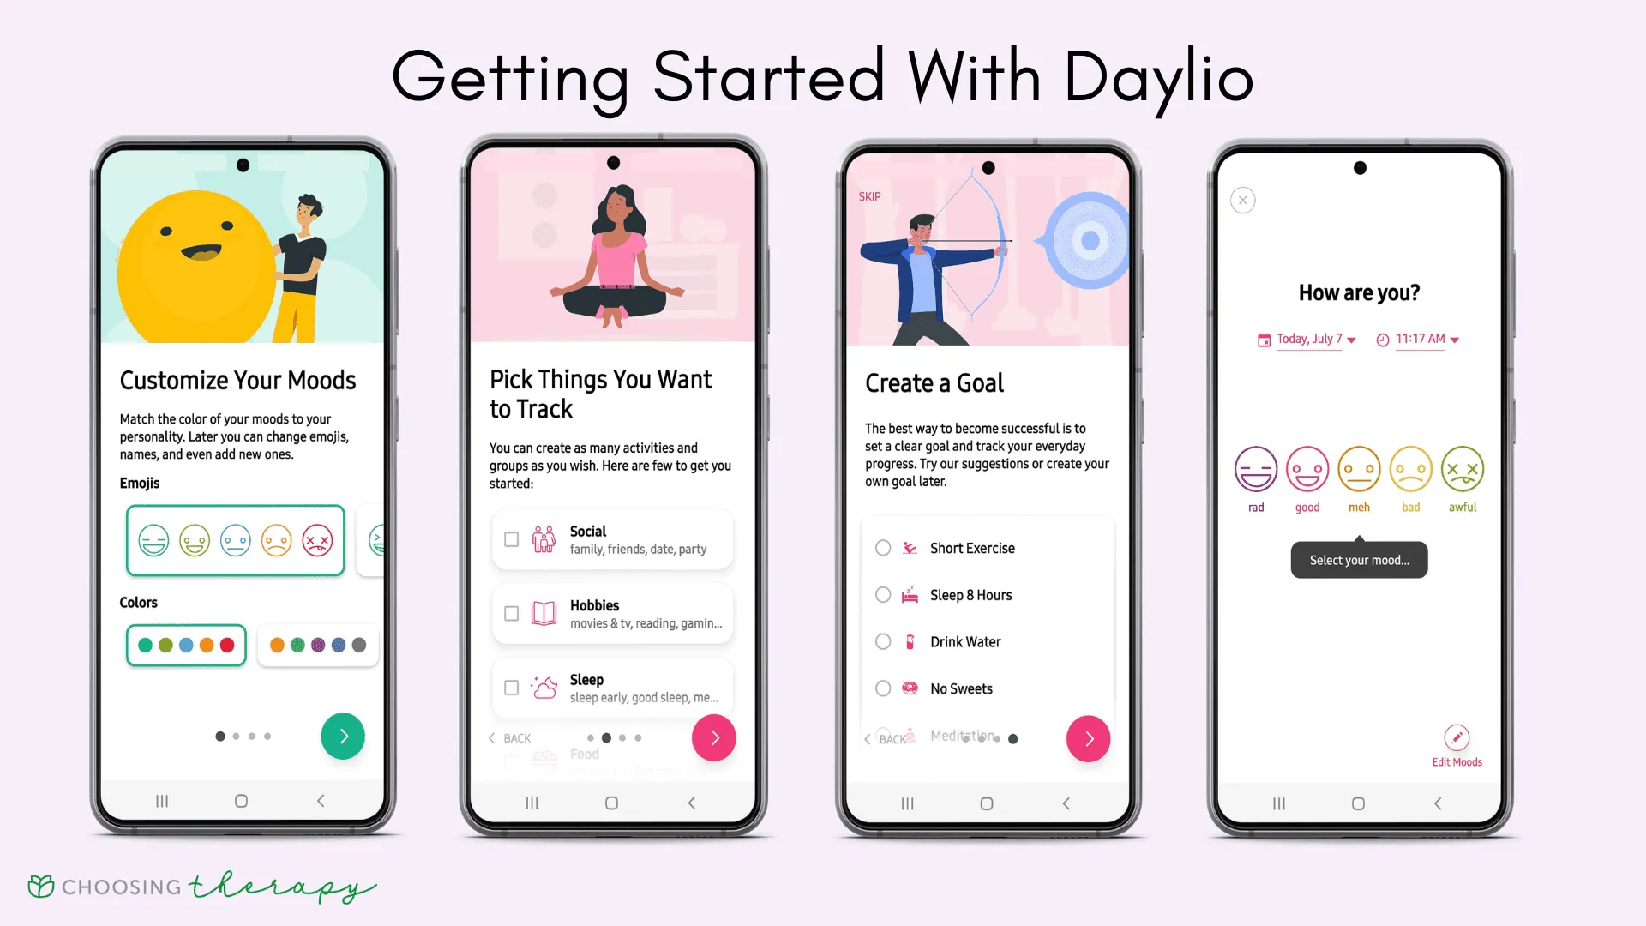
Daylio
“Keep a diary and capture your day without
writing down a single word!”
What Works
What Doesn’t
Event-Based Influence: See how often something like “good sleep” or “fast food” influences your mood
Quick Use: <5 minutes to complete a journal entry
No Written Reflection: No journal prompts, very little writing involved
Low Appeal: May not be enjoyable for users who desire an interactive app

Slide 7
Daylio
“Keep a diary and capture your day without
writing down a single word!”
Kyro integrates Daylio’s trends directly into calendar planning for smarter, emotionally-aligned time management.

Slide 8
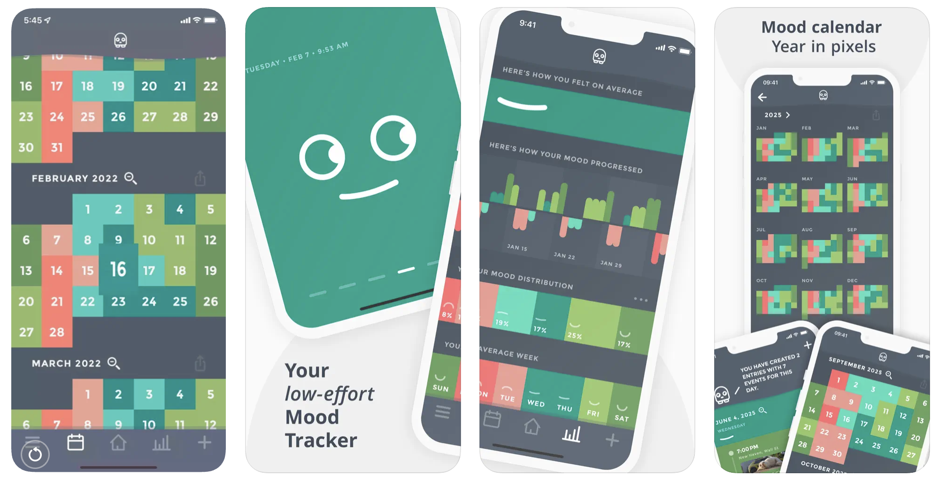
Moodistory
“Your Mood Tracker App. For Self-Improvement. Keeping Your Privacy.”
What Works
What Doesn’t
Privacy-First Positioning: “no cloud, no account, all on-device” model is popular with privacy-conscious users.
Open Features: No subscription, most features available after download
Lack of AI / Smart Insights: analytics are rule-based, not predictive.
No social or community aspect: limited long-term engagement loop.
Financial Barrier: Purchase required for download ($4-$6)

Slide 9
Moodistory
“Your Mood Tracker App. For Self-Improvement. Keeping Your Privacy.”
Kyro can combine Moodistory’s trust with adaptive intelligence, translating voice reflections into schedule insights without sacrificing data security.

Slide 10
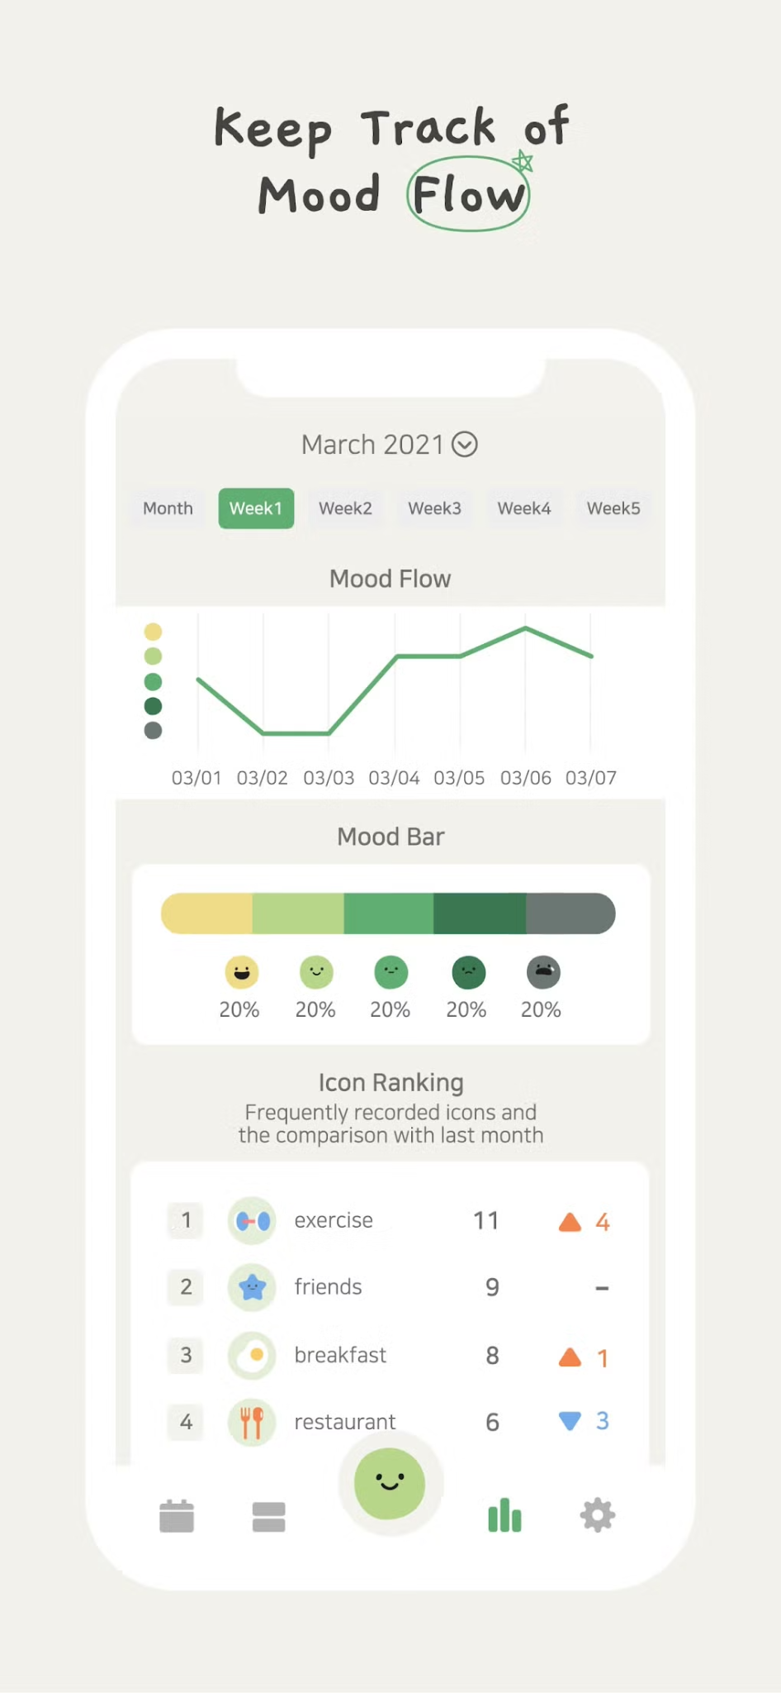
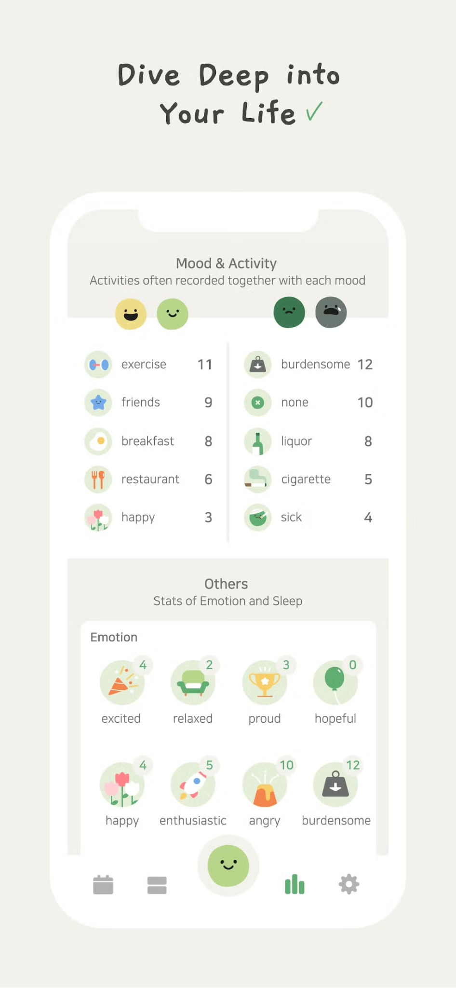
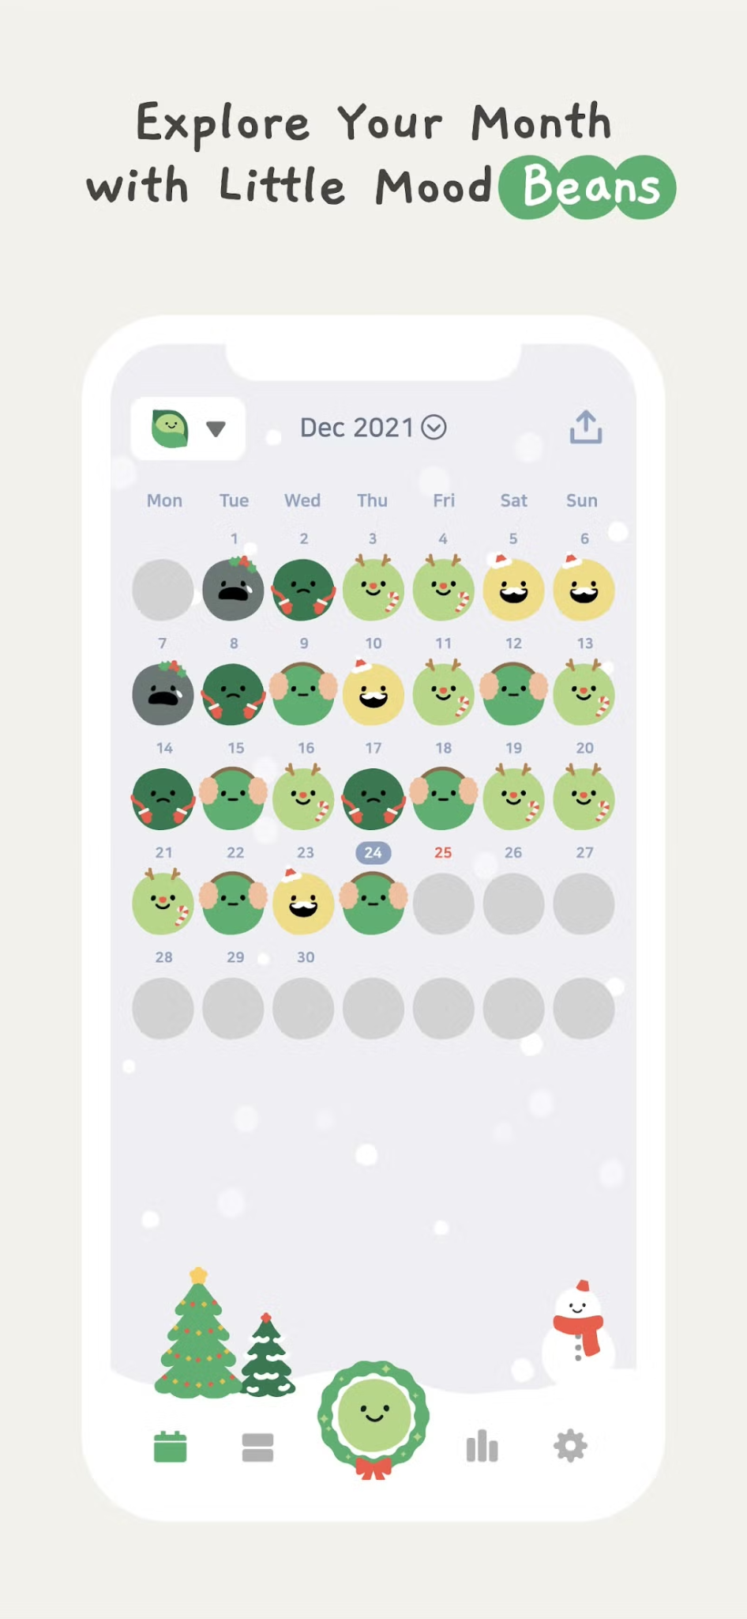
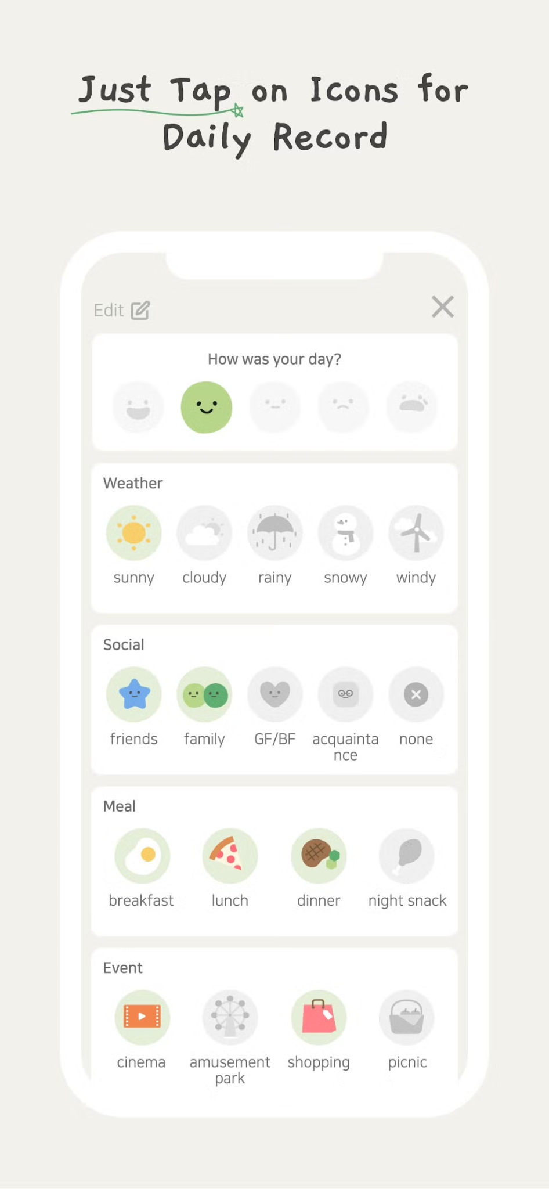
Daily Bean
“The simplest way to record your day.”
What Works
What Doesn’t
Simplicity: Based on daily habits, routine, journaling, and photo prompts
Categorical Customization: more versatility to track a variety of activities and events
Familiarity: Reminders of what type of activities can be logged.
Drop Off: Documented user engagement decline over __
Financially Inaccessible: No free version of the app
Relies on Consistency: Consistency of keeping up with filling out daily journals is more difficult.
Privacy Concerns

Slide 11
Daily Bean
“The simplest way to record your day.”
Kyro evolves Daily Bean’s simplicity into emotionally aware planning, turning quick reflections into meaningful scheduling guidance.

Slide 12
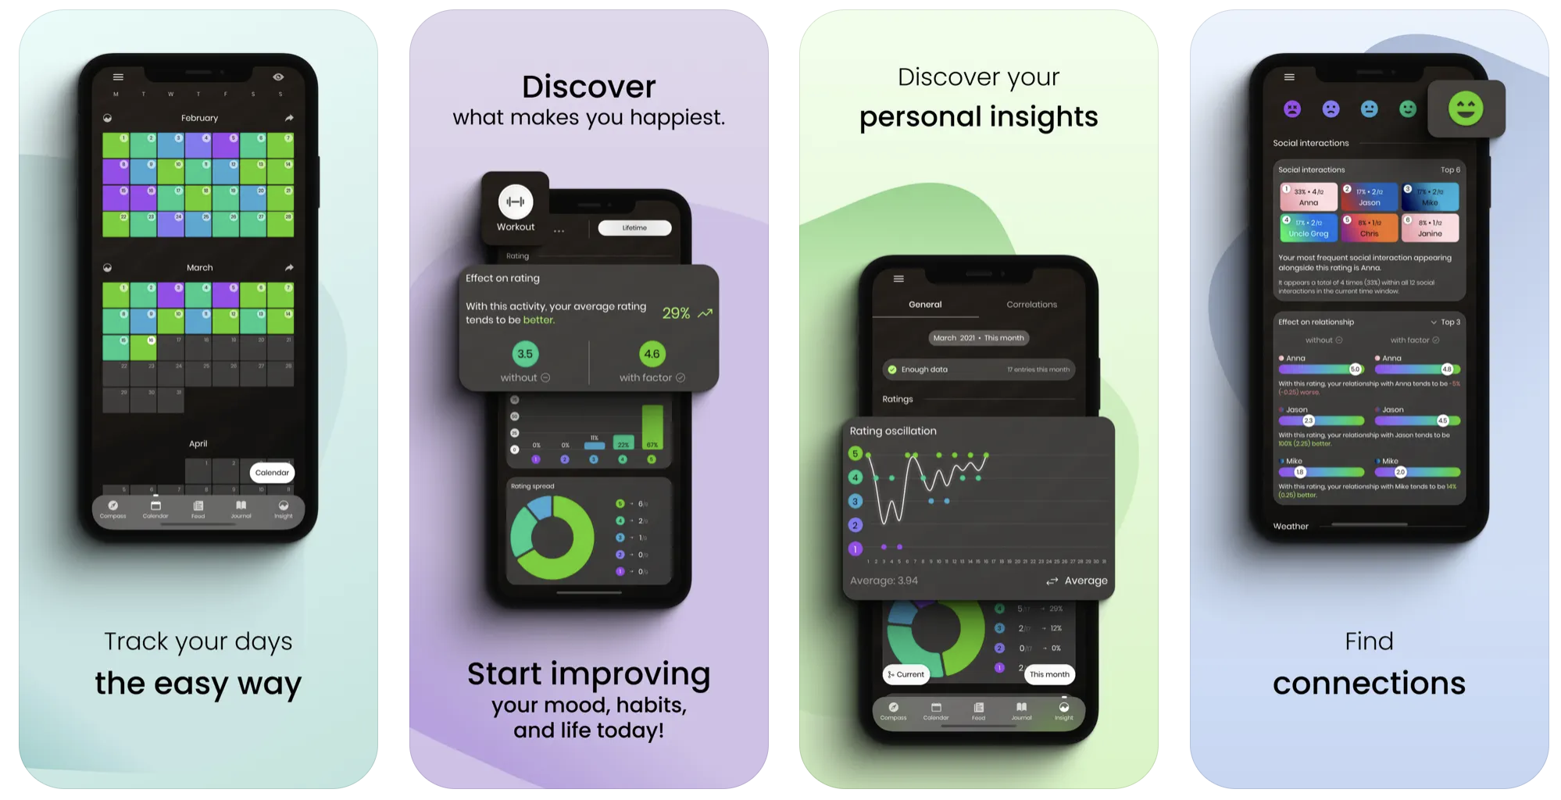
Moodflow
“The ultimate journal, diary, and mood tracking app.”
What Works
What Doesn’t
Low-effort check-ins: Quick daily entry keeps streaks alive.
Customizable & private: Users like color schemes and local-storage model.
Affordable & ad-light: Feels accessible, not exploitative.
Data trust issues: Lost-entry and backup complaints.
Weak support & Android bugs: Unreliable notifications, sync, crashes.
Limited insights: Mainly retrospective charts.
Static experience: Doesn’t connect to calendars, habits, or scheduling tools.

Slide 13
Moodflow
“The ultimate journal, diary, and mood tracking app.”
Kyro can build on Moodflow by making emotion tracking actionable, using those feelings to adjust future schedules rather than condensing days into one mood.

Slide 14



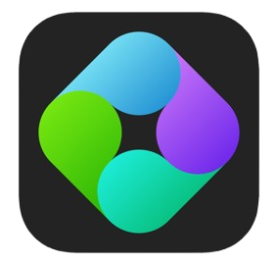
WHERE KYRO STANDS IN THE MARKET
Integrated Guidance (AI, Calendar, etc)
K
Kyro
Static Tracking
Emotional intelligence & reflection
Moodistory
Daylio
Daily Bean
Moodflow
User-Led Calendar Input

Slide 15
DIRECT STAKEHOLDERS
INDIRECT STAKEHOLDERS
People who actively use or interact with Kyro:
College students managing multiple commitments
Working professionals balancing work/life energy
Therapists or wellness coaches using insights to guide clients
People or systems affected by Kyro’s use:
Friends, classmates, and partners, benefit from better boundaries
Universities / workplaces, improved productivity and wellbeing
Health and wellness orgs, potential collaborators for mental health programs
App stores & data platforms, responsible for maintaining privacy and uptime
Kyro supports a healthy energy ecosystem, empowering users while protecting the networks around them
Notes:
What Didn't: Anonymity posed a risk. A 'crush' message felt unsettling, revealing a major design challenge.

Slide 16
ETHICAL IMPLICATIONS
Notes:
All dis

Slide 17
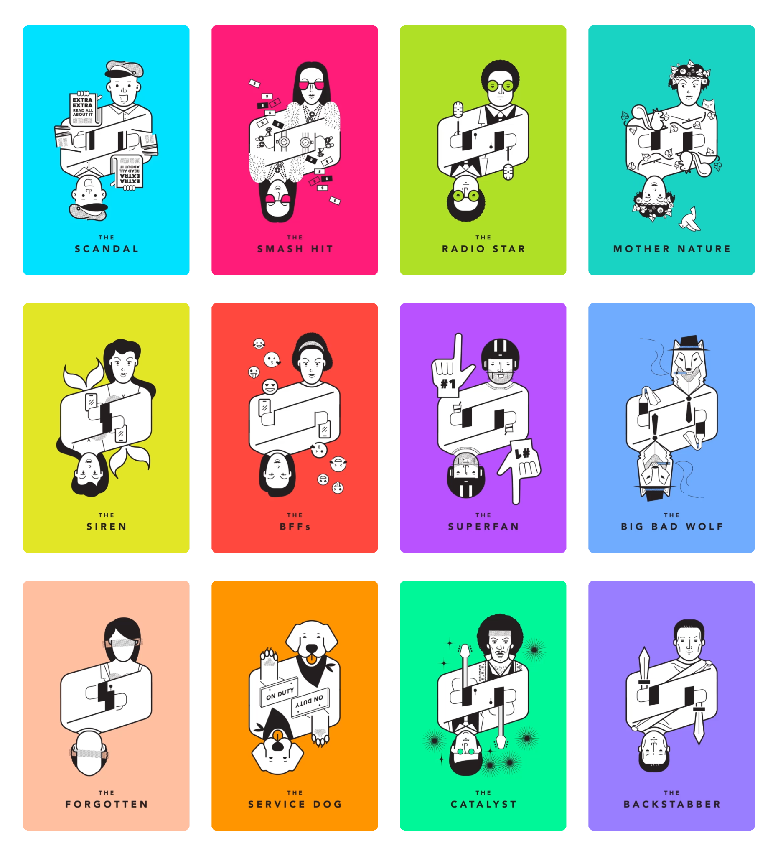
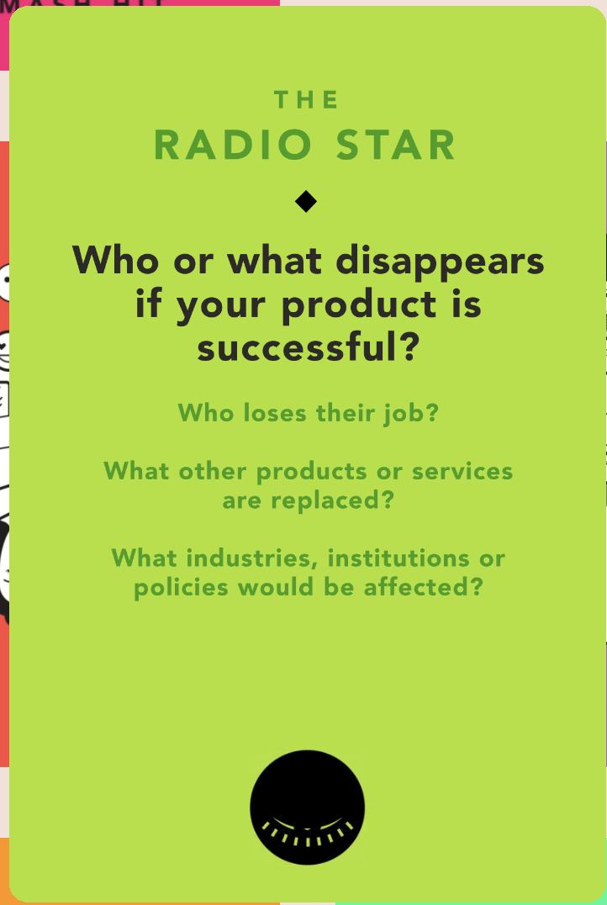
Tarot Card #1: The Radio Star
If Kyro wildly succeeds, people might eventually stop seeking therapists, life coaches, or peer support for everyday emotional guidance, relying instead on algorithmic empathy.
Potentially Overlooked Stakeholders
Those struggling with severe mental health issues could mistake Kyro’s insights for clinical advice.
-> Design Solution: We will clearly communicate that Kyro should not replace professional mental health resources; it is merely a reflective, intervention-based tool.
Ethical Implication
Users might self-diagnose or oversimplify emotions without professional guidance.
-> Design Solution: We will suggest professional resources when Kyro detects emotional distress patterns.

Slide 18
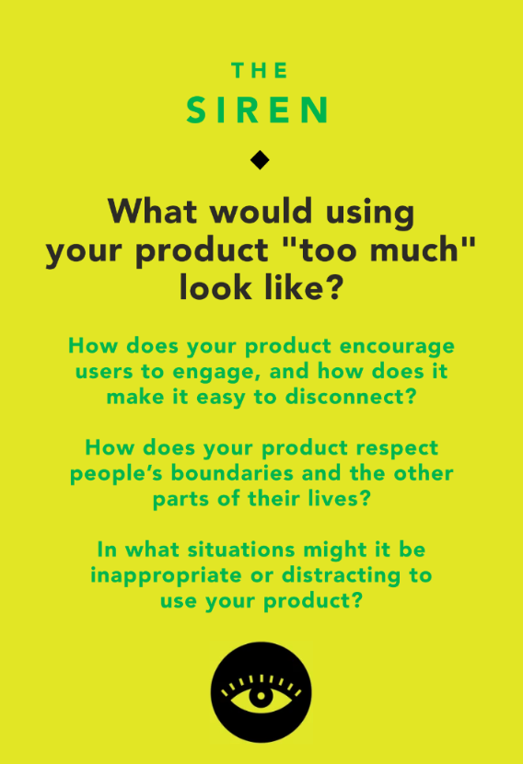
Tarot Card #2: The Siren
Overuse of Kyro could lead users to rely on the app to blindly validate their emotions instead of trusting their own intuition.
Underlying Value Tension: Mindfulness vs. Dependence
Kyro helps users reflect, but excessive tracking may turn emotional awareness into self-surveillance.
-> Design Solution: Add “take a break” nudges and gentle reminders to reflect offline
Potentially Overlooked Stakeholders
Users prone to anxiety or perfectionism might feel pressured to “optimize” their emotions if they rely on validation from Kyro.
-> Design Solution: Avoid numerical “scores” or streaks that imply performance,
include small in-app messages like “Ups and downs are normal” or “Feeling low today? That’s part of being human.”

Slide 19
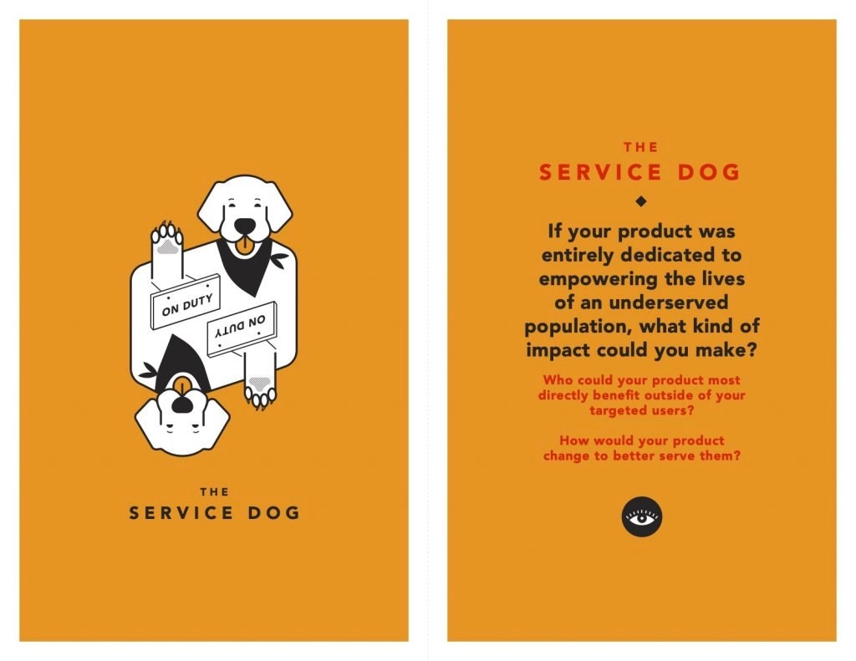
Tarot Card #3: The Service Dog
Kyro could meaningfully support neurodivergent users especially those with ADHD or autism by helping them understand emotional regulation and plan around energy patterns rather than rigid schedules.
Underlying Value Tension: Structure vs. Flexibility
Kyro provides organization and insight, but must avoid imposing neurotypical standards of productivity or emotional expression.
-> Design Solution: Let Kyro’s reminders adapt to the user’s behavior. If a user tends to log once a week instead of daily, the app learns that’s their rhythm or asks when they’d like to be reminded.
Potentially Overlooked Stakeholders
Users with sensory sensitivities may feel overwhelmed by overly complex visuals or abstract analytics.
-> Design Solution: Build a neuro-inclusive mode with simplified visuals, low-stimulation color schemes, and optional voice-based interaction

Slide 20
TASKS
Notes:
All dis

Slide 21
RECOGNIZE YOUR ENERGY LEVEL
TASK 1
Notes:
"Our first prototype tested Omar's HMW. We assumed people want reminders for things they're curious about. We had trivia-goers list things they wanted to learn and why they hadn't.

Slide 22

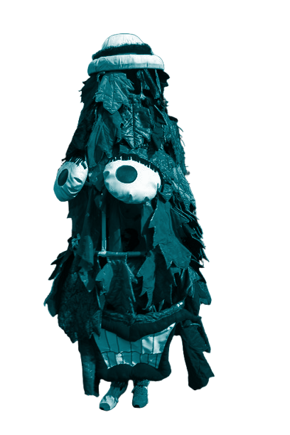
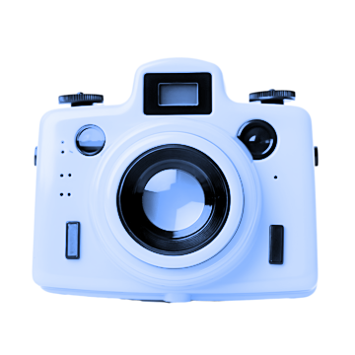
SIMPLE TASK
User goal: Users becomes aware that their “cup” is empty, realizes they’ve overextended themselves and need to recharge (approaching burnout).
Why simple: It’s an internal recognition moment that requires minimal user action, just reflection; all users will do this.
Scene in video: Main character notices her cup is empty and pauses for the first time
TIMESTAMP: 00:22 - 00:35

Slide 23
RE-EVALUATE PLANNING DECISIONS WITH KYRO’S GUIDANCE
TASK 2
Notes:
"Our first prototype tested Omar's HMW. We assumed people want reminders for things they're curious about. We had trivia-goers list things they wanted to learn and why they hadn't.

Slide 24
MODERATE TASK
User goal: Users look to Kyro’s cues for how to schedule their days intentionally.
Why moderate: It involves reflection and small but meaningful decision-making (setting boundaries). Only some users will pursue/act on these cues.
Scene in video: Kyro (glowing orb) guides main character through which events to accept, reject, and approach carefully.
TIMESTAMP: 00:43 - 01:13

Slide 25
FIND PATTERNS IN THE ACTIVITIES + PEOPLE THAT BRING JOY
TASK 3
Notes:
"Our first prototype tested Omar's HMW. We assumed people want reminders for things they're curious about. We had trivia-goers list things they wanted to learn and why they hadn't.

Slide 26
COMPLEX TASK
User goal: User ends the period of burnout by planning the day based on activities/people who replenish their energy, based on the trends recognized over time.
Why complex: This optional feature shows trends developed from data collected on the user after a long time (for accuracy). Only interested, long-term, consistent users will pursue these insights, and fewer will act on them.
Scene in video: Main character gains an insight on who she tends to have fun with and spends time with this person who adds to her energy instead of draining it.
TIMESTAMP: 01:14 - 01:28

Slide 27
STORYBOARDS
Notes:
All dis

Slide 28
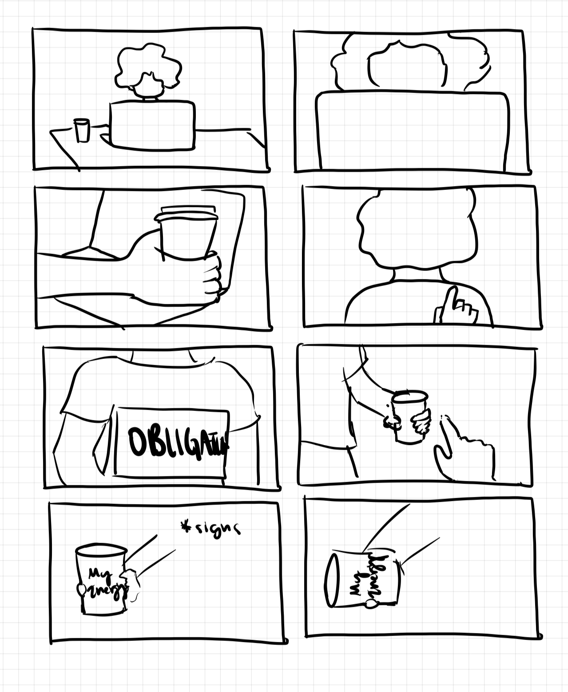
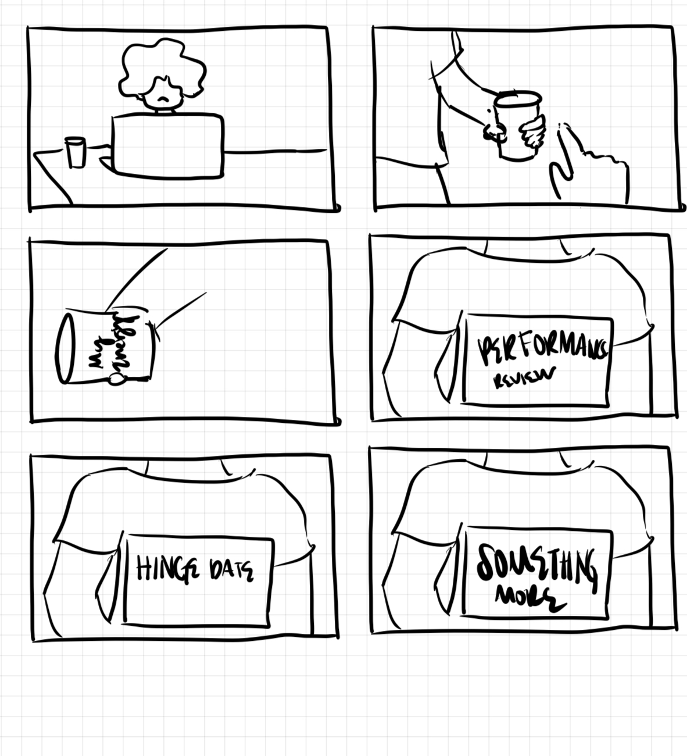
EXPOSITION

Slide 29
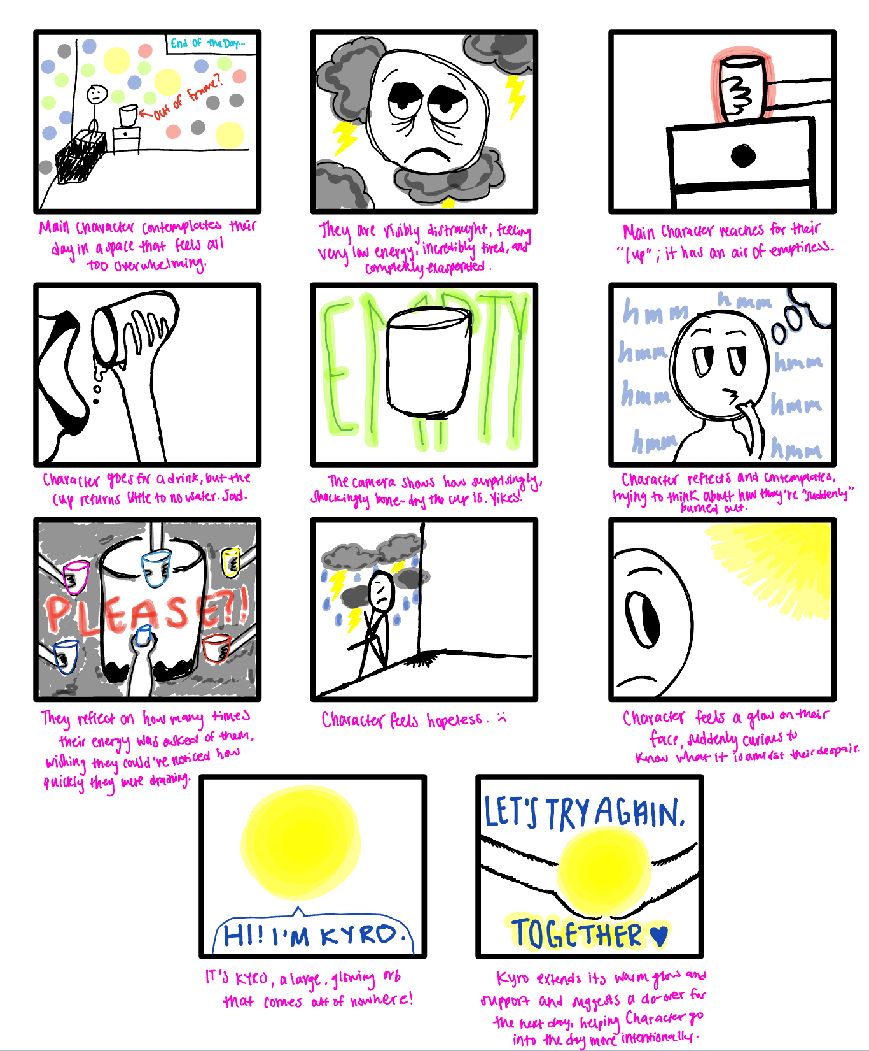
CONFLICT + CLIMAX

Slide 30
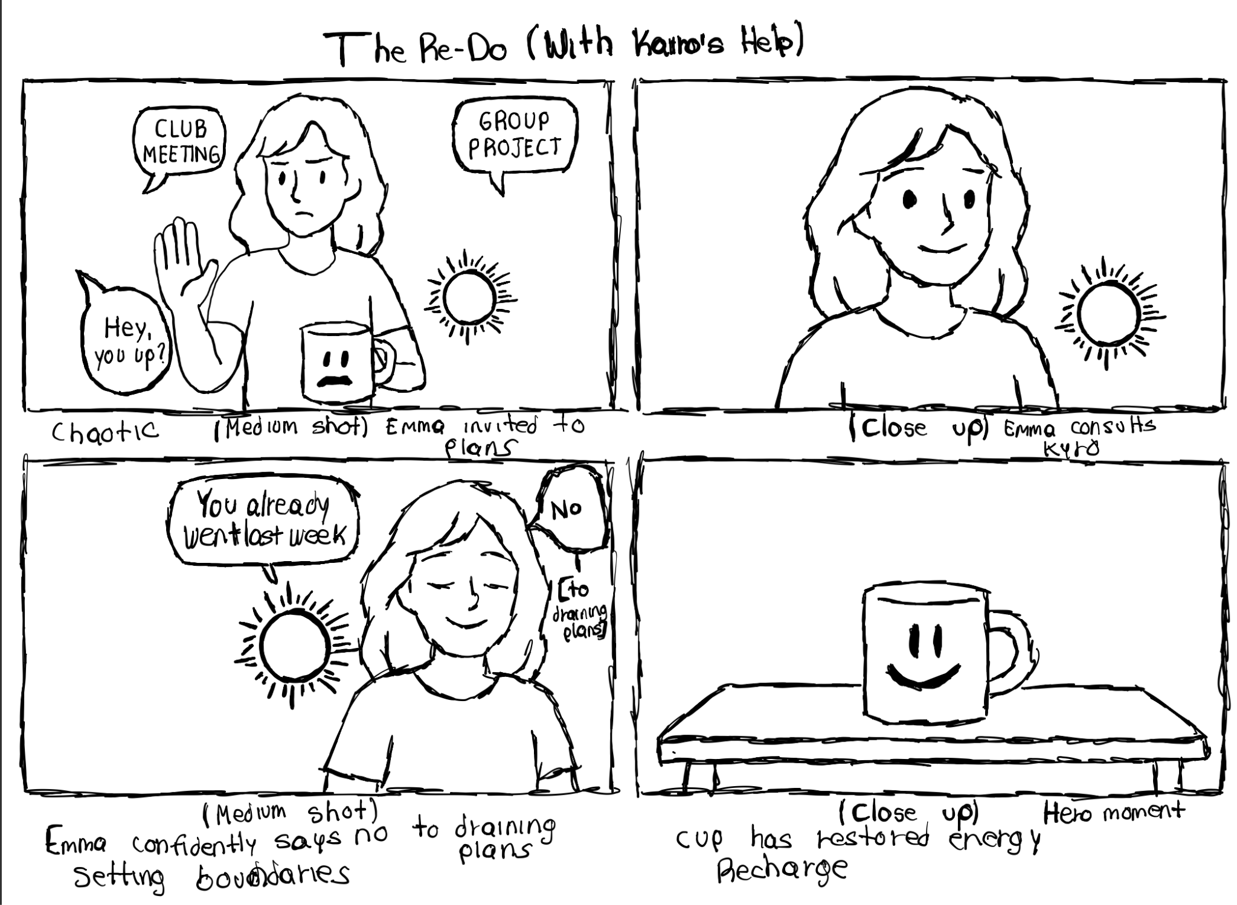
RESOLUTION

Slide 31
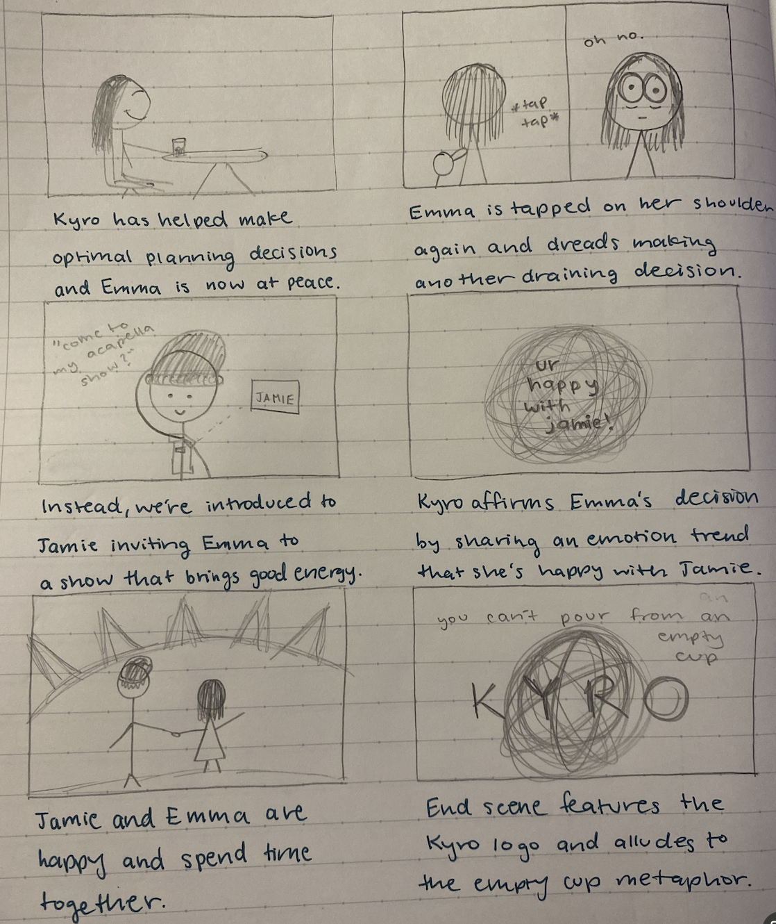
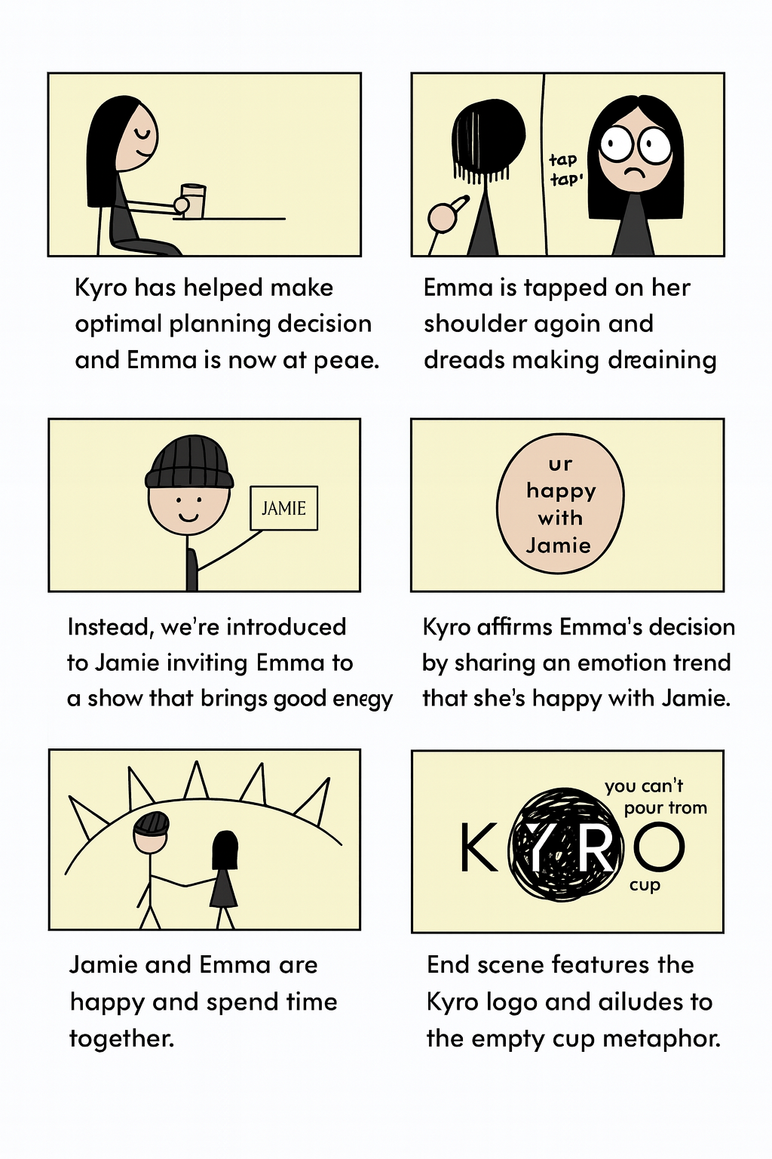
CONCLUSION

Slide 32
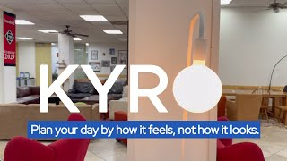
KYRO
https://www.youtube.com/watch?v=qdsYI2bFyH0

Slide 33
THANK YOU!

Slide 34
APPENDIX
Market Research Document

